Slide 1
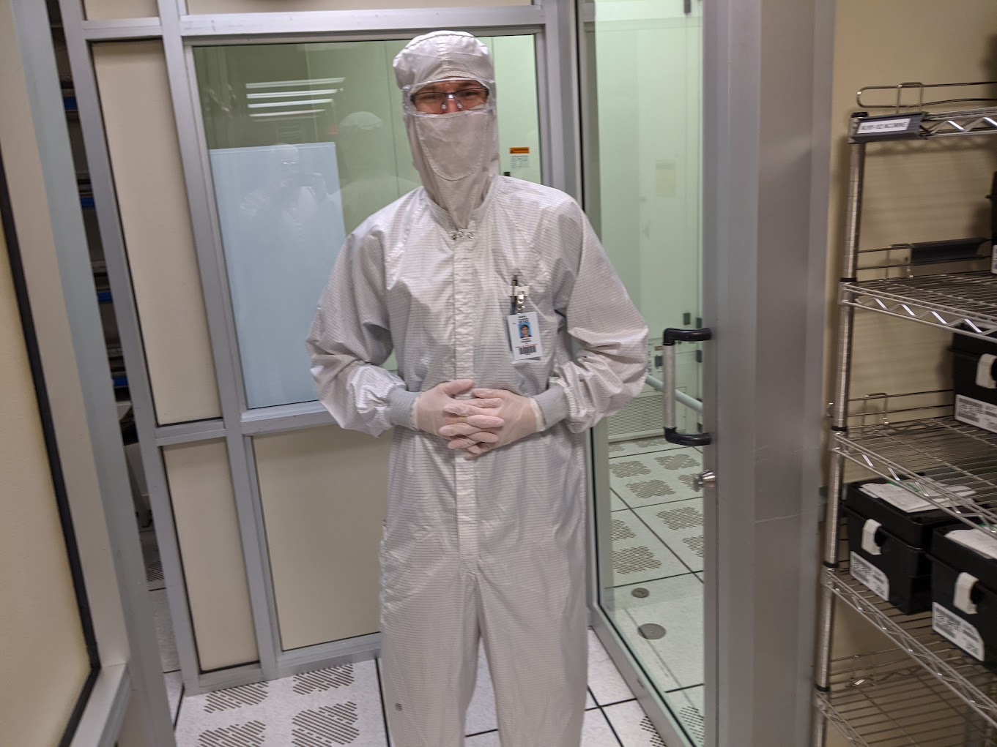
Wafer Defect Classification
Carson Branham

Slide 2
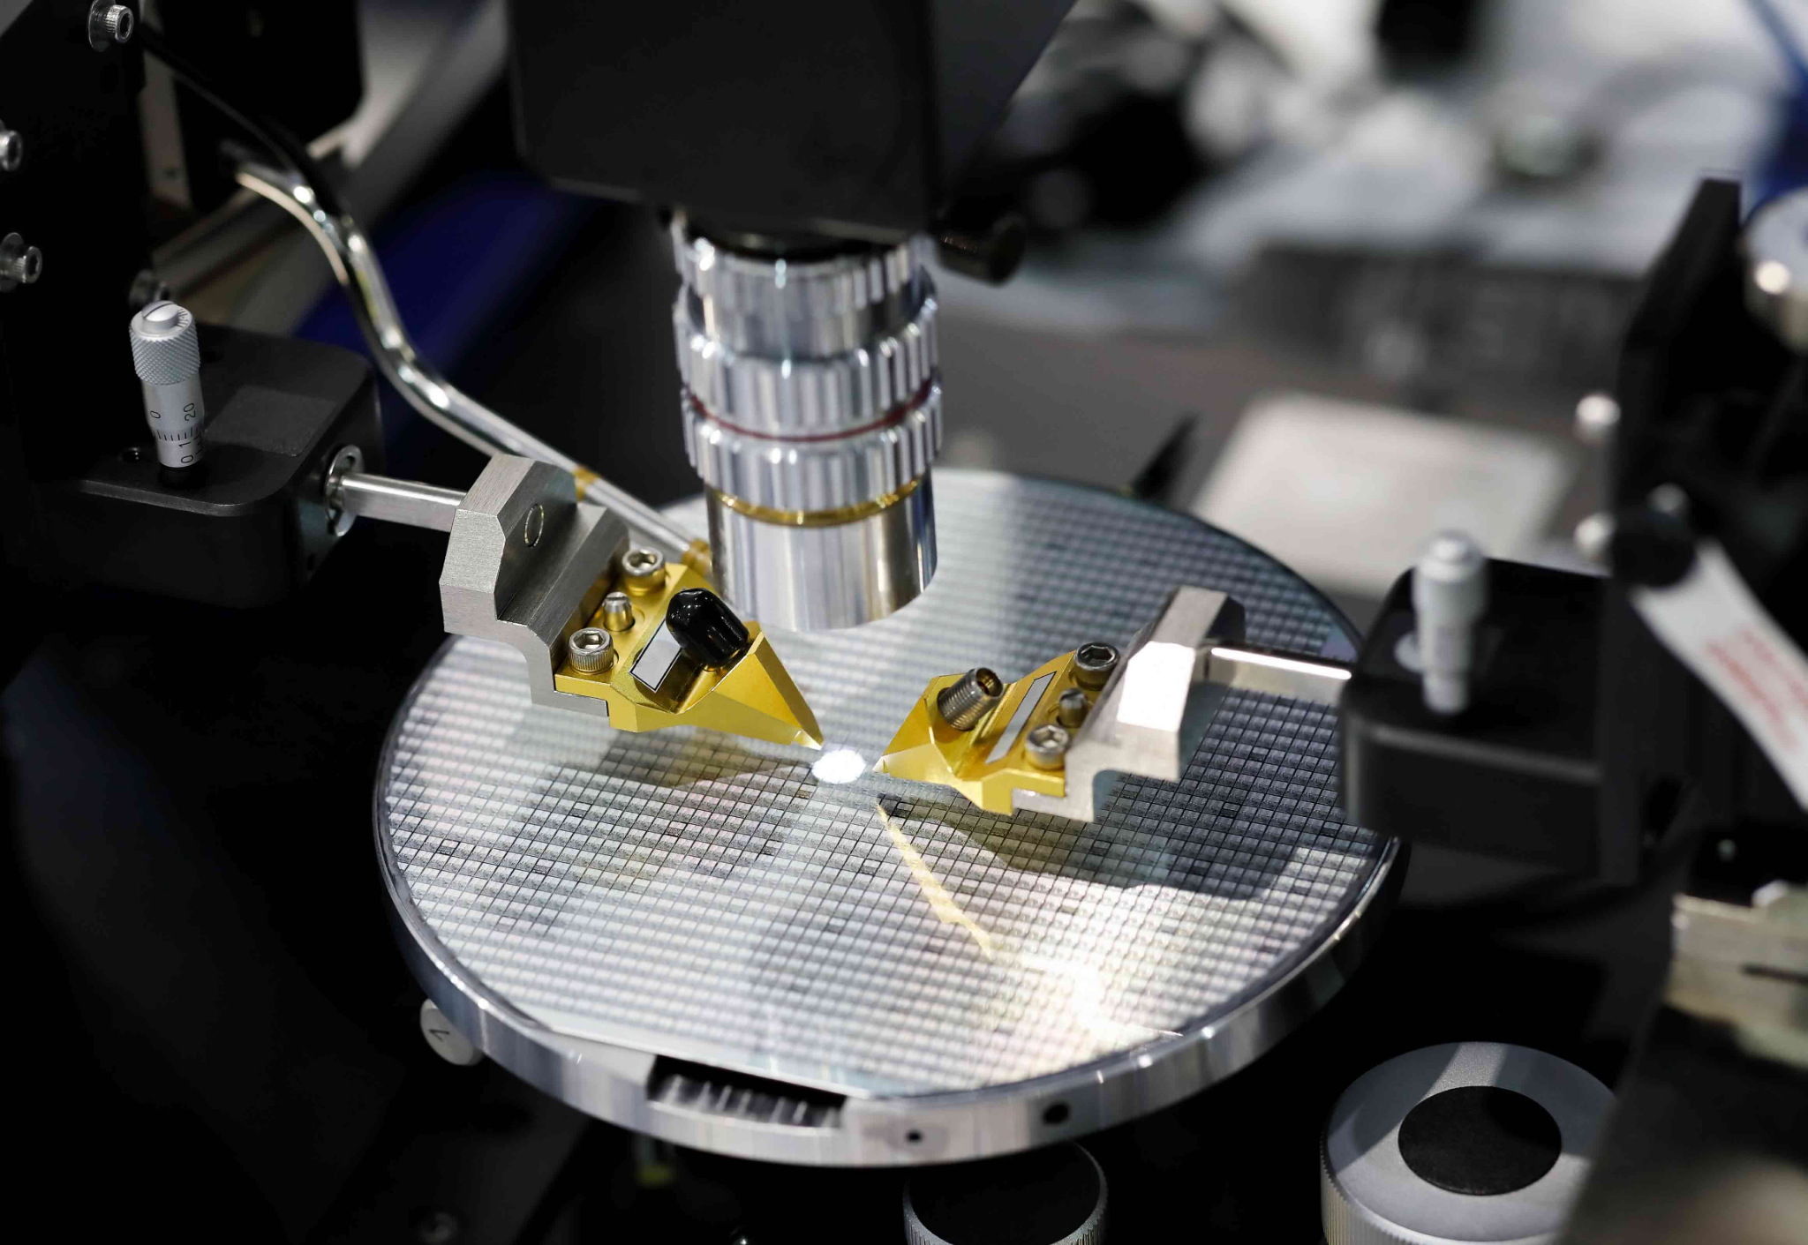
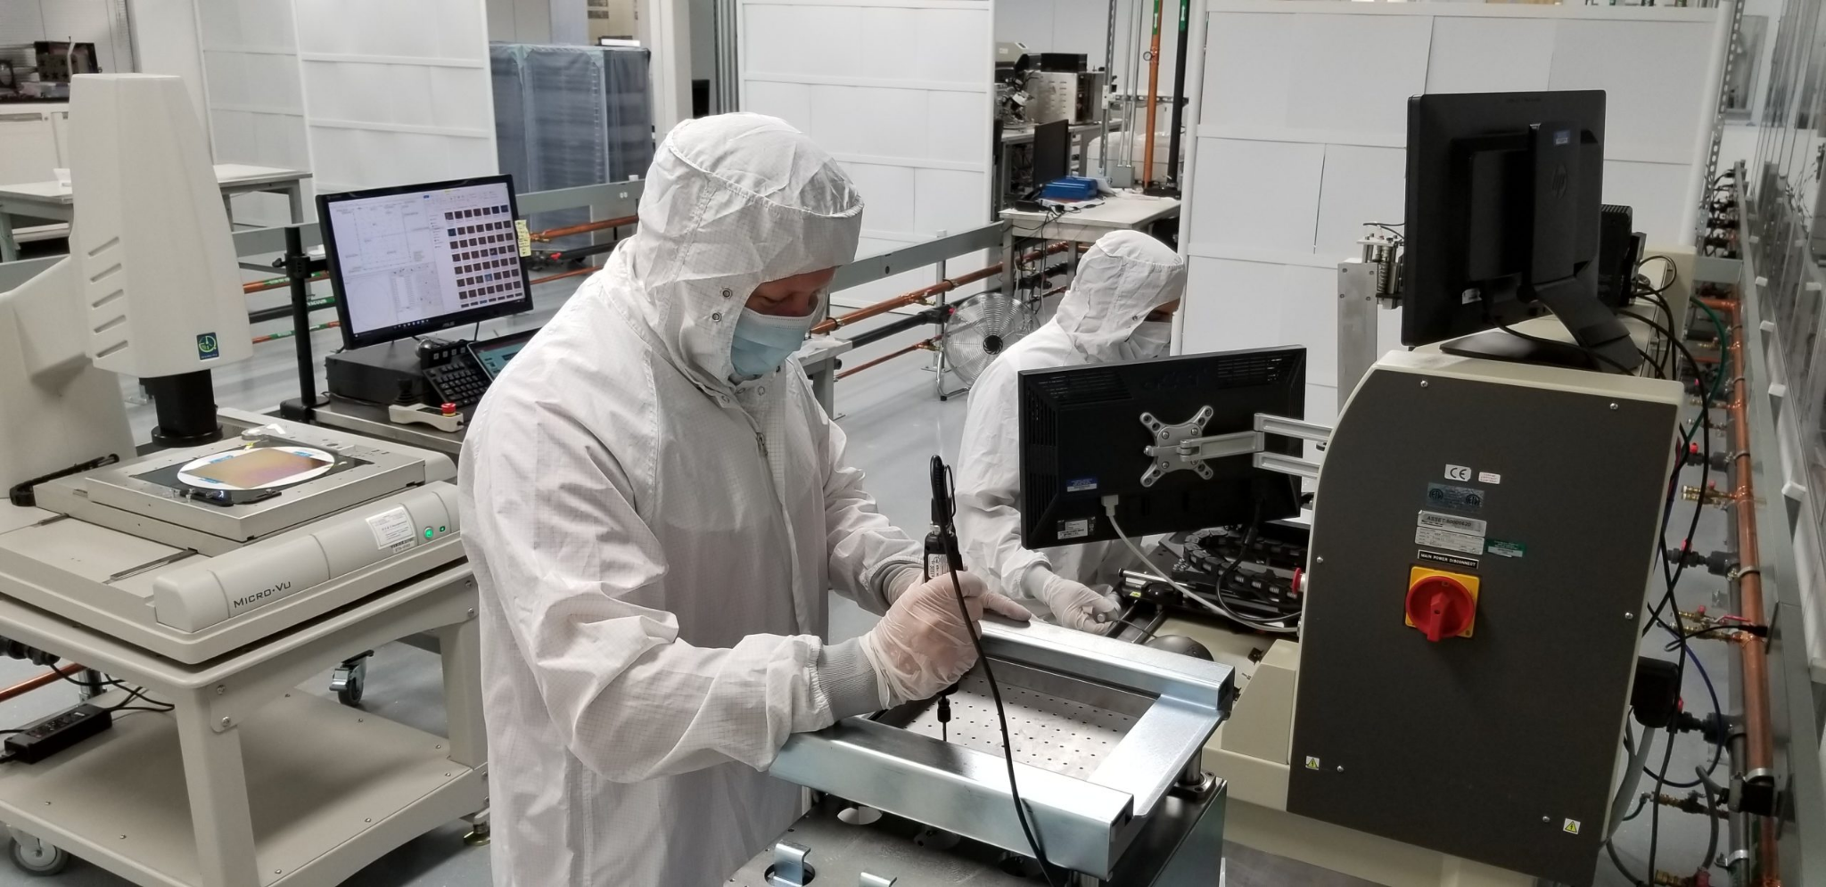
Introduction
and
Background
Silicon wafers are crucial to modern computing
Manufacturing process prone to defects
Thorough testing is required
Automating the classification of defects will improve analysis speed and production throughput

Slide 3
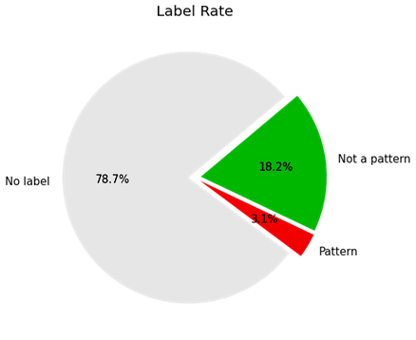
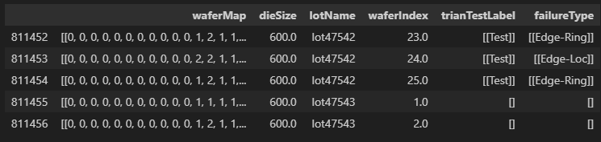
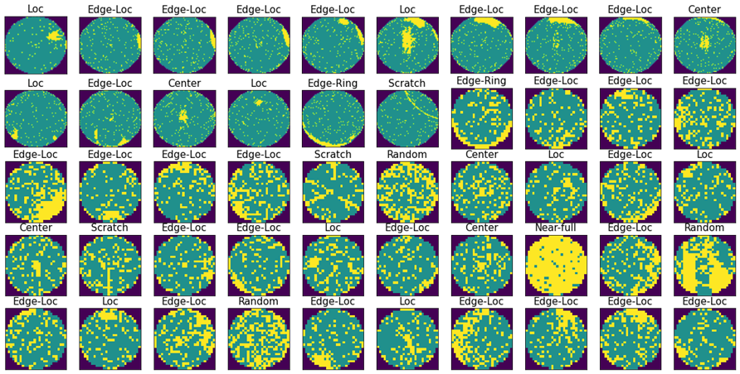
Dataset Analysis
Utilized the WM-811k dataset with 811,457 wafers
Dropped unnecessary columns and focused on labeled wafers that had fail patterns
Visually represented data

Slide 4
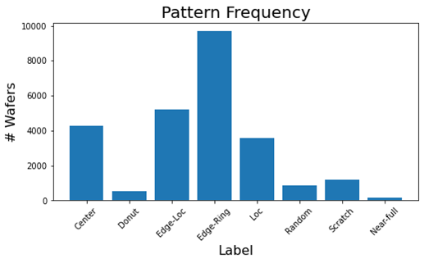
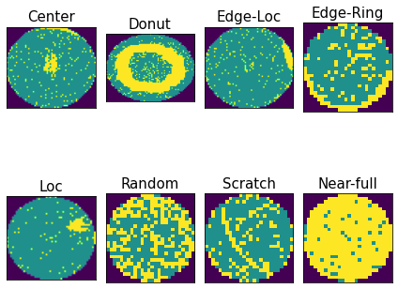
Dataset Analysis:
Fail Patterns
The following are the fail patterns considered within this dataset, along with the number they’re mapped to:
Center – 0 – faults common in wafer center
Donut – 1 – faults form a ring around the center
Edge-Loc – 2 – faults centralized in one edge location
Edge-Ring – 3 – faults spread out along an edge
Loc – 4 – faults centralized in one non edge location
Random – 5 – no pattern found
Scratch – 6 – faults form at least one line
Near-full – 7 – faults nearly make up entirety of the wafer
None – 8 – no faults

Slide 5
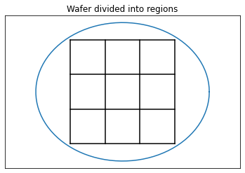
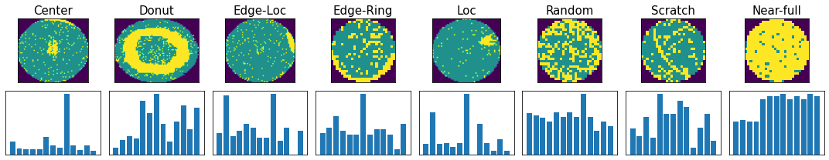
Feature Extraction: Region Density
Divides each wafer into 13 regions
Counts the number of defects in each region
These are stored as an array
Does not work well for some such as scratch
1
5
6
7
4
8
9
10
2
11
12
13
3

Slide 6
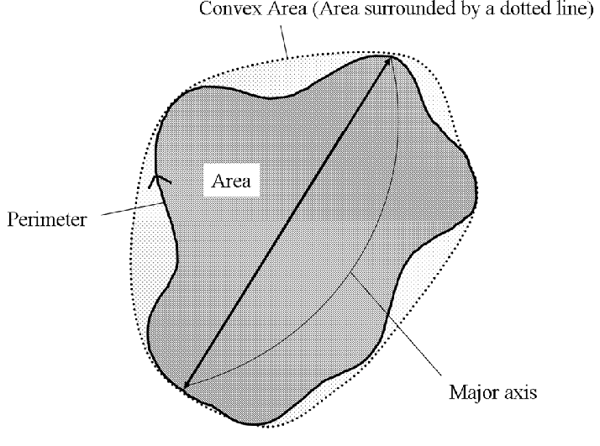
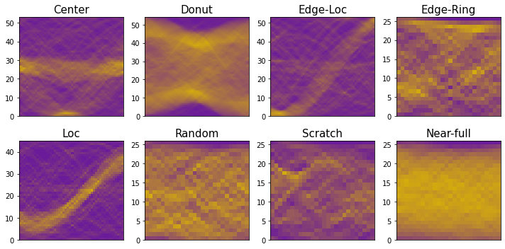
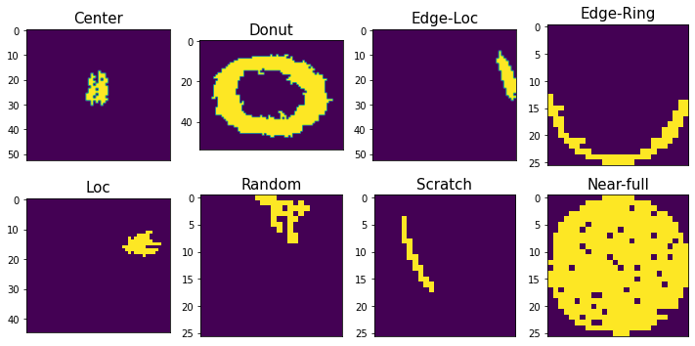
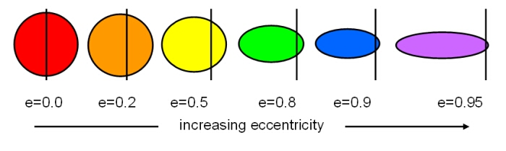
Feature Extraction:
Geometry-based
Used Radon Transformation, a variant of Fourier Transformation to reduce noise
Map each pattern and isolate geometric shapes relevant to the pattern
Take this isolated shape and measure area, length, width, solidity, eccentricity

Slide 7
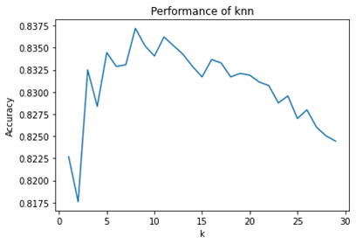
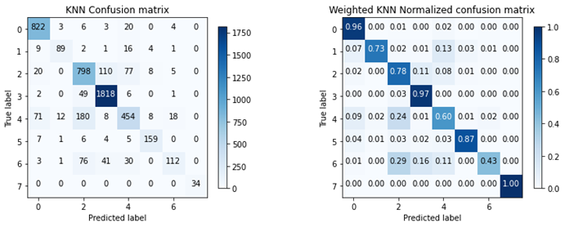
ML Model: Weighted KNN
Used Weighted KNN
started with SVM, KNN proved more accurate
does not assume distribution
robust to noise and outliers
weighted KNN gives more weight to similar points, means repeat error more likely to be classified correctly
Initial k = 5, changed to 9 due to studies
Final results 83.97% accuracy
0
1
2
3
4
5
6
7

Slide 8
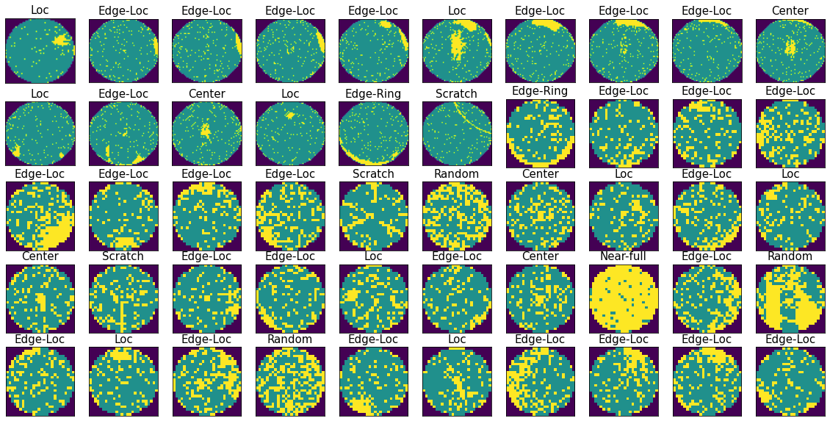
Concluding Notes
Potential for further improvement
additional features
more data for underrepresented patterns
multi-label classification
Valuable experience in feature generation
Rewarding dive into real-world application
Thanks for a great semester!

Slide 9
References
References: [1] “WM-811K” MIR Corpora. http://mirlab.org/dataSet/public/
[2] Mengying Fan, Qin Wang and B. van der Waal, "Wafer defect patterns recognition based on OPTICS and multi-label classification," 2016 IEEE Advanced Information Management, Communicates, Electronic and Automation Control Conference (IMCEC), Xi'an, China, 2016, pp. 912-915, doi: 10.1109/IMCEC.2016.7867343.
[3]
“Silicon Wafer Manufacturing: From Sand to Silicon | Wafer World,” www.waferworld.com. https://www.waferworld.com/post/silicon-wafer-manufacturing-from-sand-to-silicon#:~:text=Definition%20of%20Silicon%20Wafer%20Processing&text=The%20process%20involves%20converting%20raw (accessed May 08, 2024).
‌ [4]
“What is a silicon wafer? What is it used for?,” WaferPro, May 28, 2017. https://waferpro.com/what-is-a-silicon-wafer/

